Slide 1
FEM2401 Malaysian Politics & Society TOPIC 7: FEDERAL SYSTEM
Lecturer:
MUHAMMAD AMIR BIN MUNSHI

Slide 2
OUTLINE
Basic concept of federalism
Federalism in Malaysia: federal and state government
State administration and local government
LEARNING OUTCOME
To understand about the system of government
To understand the basic concept of federalism
To describe the practice of federalism in Malaysia
To explain the structure of state (including district) administration and local government

Slide 3
SYSTEM OF GOVERNMENT
UNITARY
Central government holds most of the power.
Central governments acts directly on the citizen/provinces.
Local governments exercise powers granted to them by the central government.
UK, New Zealand, Sweden, China, Indonesia, France
CONFEDERATION
A confederation is a system of government in which sovereign states delegate power to a central government for specific purposes. Power centered in states
Germany in 19 century, European Union, United Nation, OIC, Switzerland?
FEDERAL
A division of power between the central government and state, provincial or local governing. Such division is specified in the constitution.
USA, Canada, India, Australia, Germany

Slide 4
WHAT IS FEDERALISM?
‘Foedus’ (Latin) – covenant, compact, treaty, league or an alliance between states for mutual support and joint action
K.C. Wheare (father of federalism theory) “ a method of dividing powers so that the general and regional governments are each, within a sphere, coordinate and independent."
“A constitutional division of governmental power between the national and the constituent units,”

Slide 5
THE CONCEPT OF FEDERALISM
Federalism requires that the federal and state governments should each "be limited to its own sphere“.
A written constitution is one of the key characteristics of federalism. It would define the boundaries of authority for each government.
Without a written constitution, the federal government can easily encroach upon or usurp the authority of the state governments, possibly leading to chaos. Each government has a sovereign power derived from the constitution
Each government is also empowered to deal directly with its citizens in the exercise of its legislative, executive and taxing powers and each is directly elected by its citizens
In federalism, political authority is divided between a central government (federal government) and a collection of state (or regional) governments, acting side by side and sharing a large geographical space.
The authority of federal government is exercised supremely over many areas of public policy.
For example, the central/federal government carries out the security and diplomatic functions of the country, as well as other important issues of national concern. Meanwhile the state government has a responsibility over local issues such as water and local customs.
In brief, power is divided based on jurisdiction. Each government is co-equal and has a sovereign power over matters in its control.

Slide 6
ADVANTAGES OF FEDERAL SYSTEM
Allows smaller states to join with bigger states without losing the freedom and rights of self government
When states join together, a Federation will be stronger economically and politically, as well as increasing the number of citizens.
The pattern of federal system of administration allows the concerns of the locals to be voiced out and heared by at the Federal level to be settled.
Allows the uniformity in application and enforcement of policies for the entire country
Able to control the Federal Government so it is not too strong and does not step on the interest of the State Government

Slide 7
DISADVANTAGES OF THE FEDERAL SYSTEM
Competition for power often occurs between Federal and State Government, for example on the issue of financial contribution by the Federal Government
It is possible that states may adopt certain policies to protect the interest of their own state
System of administration is costly and complicated, especially when the same administrative institutions needs to be created in each state
Often results in feelings of dissatisfaction amongst member states joining the federation.

Slide 8
BACKGROUND OF FEDERALISM IN MALAYSIA
The system was first introduced by the British through 1896 Federated Malay States
In 1914 – Malay Land was like a ‘confederation’ because of 3 different systems at once : Federated Malay States, Unfederated Malay States and Straits Settlement
Federation of Malay Land in 1948 – replaced the unitary concept of Malayan Union 1946
Federation of Malaya 1957 - independence
Federation of Malaysia 1963 – the merger with Singapore, Sabah and Sarawak

Slide 9
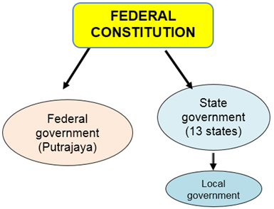
FEDERALISM IN MALAYSIA
The Constitution of Malaysia (or also called as the federal Constitution) is the supreme law – it is written that Malaysia is a federation country and practice a parliamentary democracy
Comprises of two (2) governments – federal and state. Local government is under the authority of state government.
13 states with three (3) federal territories
Both level of government has three (3) branches ; executive, legislative and judiciary with the King/YDPA as the head of the government as a whole.

Slide 10
The constitution of Malaysia (written constitution) is the main reference/source in understanding the distribution of power and relationship between federal and state government
Article 74 of the Federal Constitution describes the distribution of legislative powers between Federal/National and state governments.
The Ninth Schedule of the Constitution provides three lists:
Federal list –the matters which are under the purview of Parliament (Federal Government).
State List – the matters under the jurisdiction of the Dewan Undangan Negeri(State Assembly) of the individual states (State Government).
Concurrent List - contains matters where both Parliament and the Dewan Undangan Negeri may legislate on.
Federal government
3 federal territories
Putrajaya: central of administration
Kuala Lumpur – capital of Malaysia
Labuan – federal territory for the East Malaysia
State government
13 states government based on the 13 states
Perlis, Kedah, Pulau Pinang, Perak, Selangor, Negeri Sembilan, Melaka, Johor, Pahang, Terengganu, Kelantan, Sabah and Sarawak.

Slide 11
NINTH SCHEDULE OF THE FEDERAL CONSTITUTION, CONTAINING THE FEDERAL LIST, THE STATE LIST, AND THE CONCURRENT LIST
Federal List | State List | Concurrent List
Foreign Relations Defence Internal Affairs Citizenship Finance Trade Education Tourism | Islam Land Forestry Local government State water and works State holidays Local custom | Scholarships Social Welfare Vagrancy Town Planning Public health and sanitation Culture and sports Housing Theatre, cinema, and places of public amusement

Slide 12
THE PRACTICE OF FEDERALISM IN MALAYSIA
Each government is superior in their power/jurisdiction based on the constitution provision
Any areas not specified in the constitution is fall under the state authority.
In practice, the nature of federation in Malaysia – the areas under the federal government are more comprehensive – creating a situation like a centralised government or the dominance of federal government
Some areas are superseded / can be overridden by the federal government

Slide 13
POWER OF FEDERAL GOVERNMENT SUPERSEDES STATE GOVERNMENT
Power to alter state line (Article 2b)
Federal constitution is the supreme law [Article 4(1)]
Federal law shall prevail if State law are inconsistent with federal law (Article 75)
Federal government has power to make law (Article 73)
Power of federal government of State list (Article 76)
The extent of federal and State laws is stated in Article 73 :
parliament may make laws for the whole or any part of the Federation and laws having effect outside as well as within the Federation;
the Legislature of a State may make laws for the whole or any part of that State

Slide 14
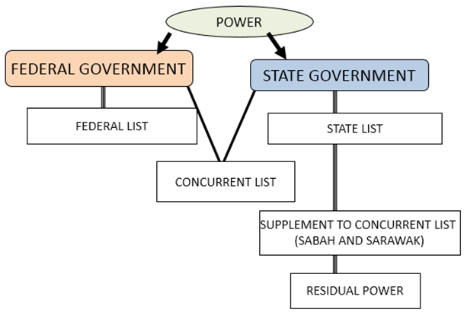
RESIDUAL POWER (State government)
State government matter – any matters which is not in any lists in the Constitution
Article 77:
The State have power to make laws concerning matters not in any of the Lists in the Ninth Schedule.
RELATIONSHIP BETWEEN FEDERAL AND STATE GOVERNMENT

Slide 15
STATE ADMINISTRATION
System and structure of state
Executive Power
State Executive Body
Legislative Body
Administrative Coordination
State Administration Machinery
State Public Services
Government Agencies
Office of State Sectretary
Office of State Finance
Office of State Legal Advisor
Economic Development of State Unit
State Administration Level
District Administration
Mukim Administration (Sub-district)
Village/Kampung Administration
Local Government/Authorities

Slide 16
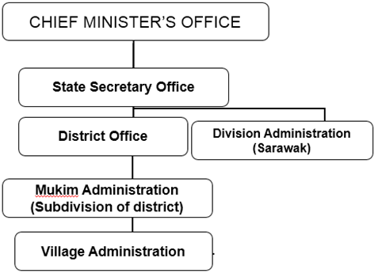
STATE ADMINISTRATION
Most of the states have similar structure of administration – 3 levels of administration
District
Mukim (Sub-division of district)
Village
EXCEPT:
Sabah only has two levels – District and Village only
Sarawak has four levels
Division
District
Sub-district
Village
STATE ADMINISTRATIVE MACHINERY

Slide 17
STATE EXECUTIVE BODY
The Malay Ruler (Sultan) and the Yang di-Pertua Negeri/YDN (State Governor)
Head of the state government
Appoints the Chief Minister
Approves the appointment of the State Executive Council (Exco)
Acts upon the advice of the State Executive Council
State Executive Council
Advises the Sultan/State Governor in administrative matters headed by the Chief Minister
Each Exco member heads an administration of a state
Chief Minister
Leads the state administration
Created in accordance with the State Constitution
Member of State Legislative Assembly and Exco

Slide 18
STATE LEGISLATIVE BODY
State Legislative Assembly
Enacts state laws
Scope of tasks, power and membership determined by State Constitution
One legislative assembly only
Member from election of State Legislative Assembly
3 members from orang state administration (ex-officio): Secretary of State Government, State Legal Advisor, State Finance Officer

Slide 19
COORDINATION OF ADMINISTRATION BETWEEN FEDERAL AND STATE GOVERNMENT
The relationship between Federal and State administration through:
Council of Rulers
National Monetary Council
National Land Council
National Council for Local Government
Senate

Slide 20
LOCAL GOVERNMENT
Provides autonomy to the local people to administer their own region
Improves the quality of life of the locals
Includes the locals in the administration and management of their affairs and interests
Provides social and service facilities such as the maintenance of public areas, collection of rubbish, general health, providing sewerage system
Minor jurisdiction in:
Power to enact by-laws
Prosecute, acquire wealth, enter into contracts, collect rent and taxes
Government control through Ministry of Housing and Local Government

Slide 21

Local Government
Jurisdiction of Local Government:
Pass by-laws
Impose taxes, rent, and service charge used by local residents
This financial source is then used for funding of management
Logo of the Kuala Lumpur City Hall (DBKL)

Slide 22

Image of Night Market in Jalan Tuanku Abdul Rahman, Kuala Lumpur
Matters relating to rent and providing space for night market are under the jurisdiction of local governments

Slide 23
ISSUES IN THE RELATIONSHIP BETWEEN STATE AND FEDERAL GOVERNMENT
Exiting the Federation
Differences in political ideologies-when State Government lead by Opposition Party (opposite ideology)
Financial issues

Slide 24
CONCLUSION
Federation is a good system for Malaysia
A good relationship between federal and state government is important
Federal government must act in accordance with the rules underlined in the constitution to ensure a fair system of administration

